Slide 1

Hash Based Signatures
Halil İbrahim Kaplan
TDD / Kripto Analiz Laboratuvarı
halil.kaplan@tubitak.gov.tr
2024

Slide 2

Overview
Hash Functions and Security
Lamport One-Time Signiture
Merkle’s tree-based signature
WOTS/WOTS+
XMSS
FORS
SPHINCS+
Antonov’s Attack
Halil İbrahim Kaplan
Hash Based Signatures

Slide 3
Hash Functions and Security
Authenticity
The identity of the organization that sent the message (the message signer) is confirmed.
Integrity
The message content was not changed or tampered with since it was digitally signed.
Digital signatures assures
Nonrepudiation
The origin of the signed content is verified to all parties so the message signer cannot deny association with the signed content.
Halil İbrahim Kaplan
Hash Based Signatures

Slide 4
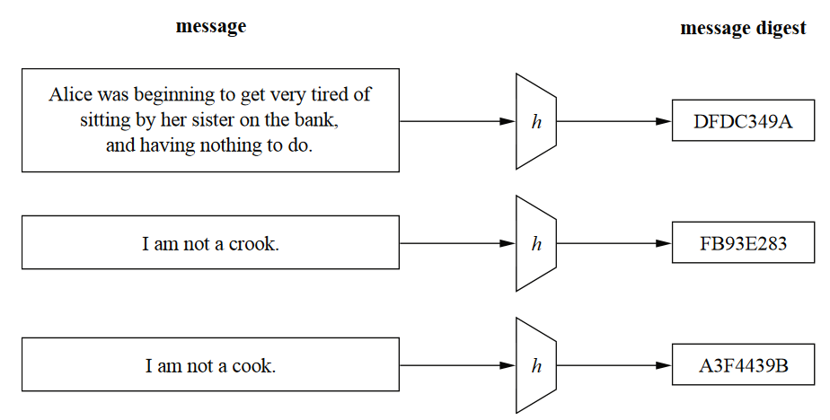
Hash Functions and Security
Halil İbrahim Kaplan
Hash Based Signatures

Slide 5
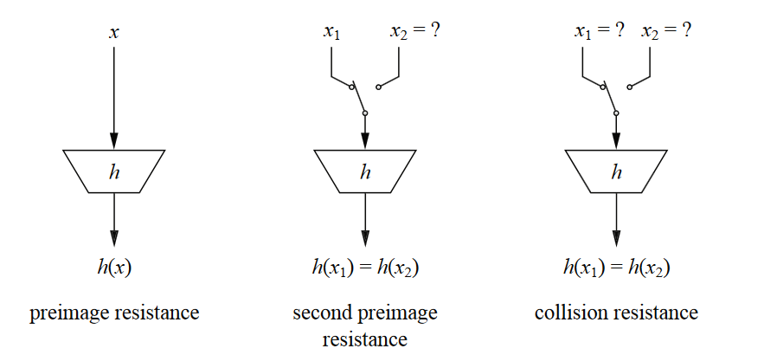
Hash Functions and Security
Preimage resistance:
Given h(x) it should be infeasible to find x
Halil İbrahim Kaplan
Hash Based Signatures

Slide 6
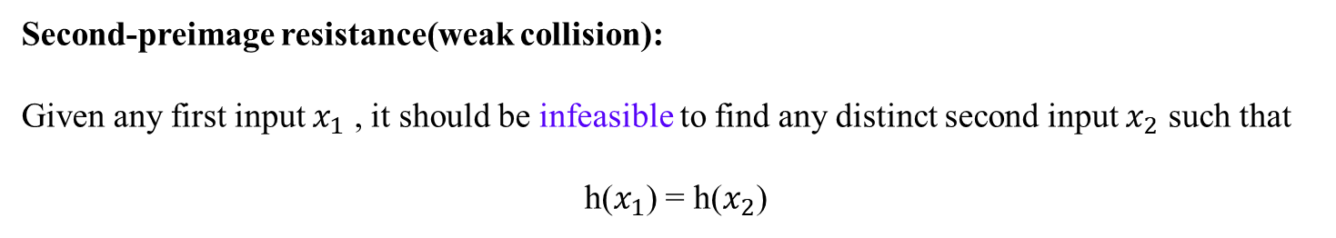
Hash Functions and Security
Second-preimage resistance(weak collision):
Given any first input $x_{1}$ , it should be infeasible to find any distinct second input $x_{2}$ such that
h($x_{1}$) = h($x_{2}$)
Halil İbrahim Kaplan
Hash Based Signatures

Slide 7
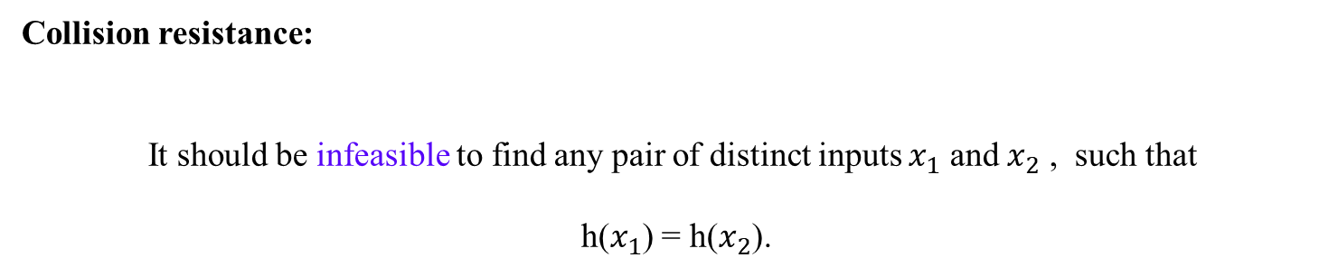
Hash Functions and Security
Collision resistance:
It should be infeasible to find any pair of distinct inputs $x_{1}$ and $x_{2}$ , such that
h($x_{1}$) = h($x_{2}$).
Halil İbrahim Kaplan
Hash Based Signatures

Slide 8
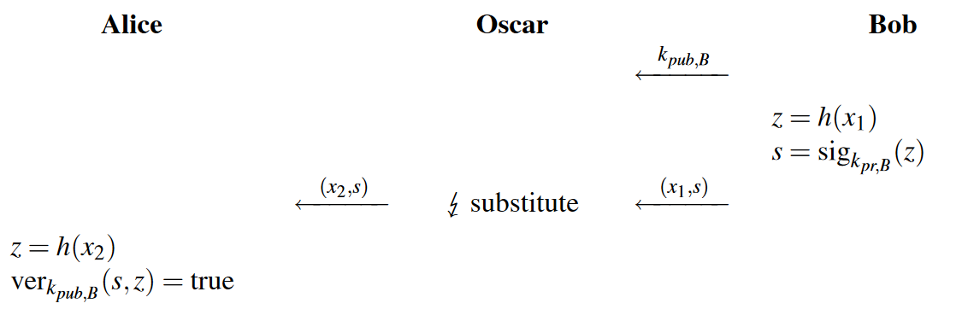
Hash Functions and Security
Ideally, we would like to have a hash function for which weak collisions do not exist.
This is, unfortunately, impossible due to the pigeonhole principle
Halil İbrahim Kaplan
Hash Based Signatures

Slide 9
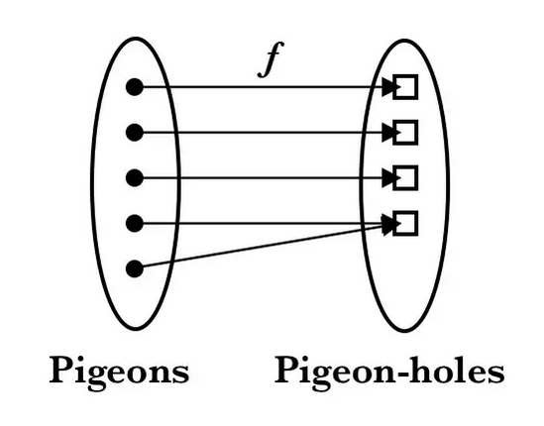
Hash Functions and Security
So we say infeasible
Halil İbrahim Kaplan
Hash Based Signatures

Slide 10
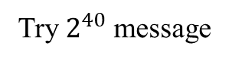
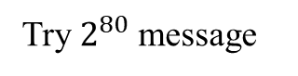
Hash Functions and Security
How common collisions for 80 bit hash output ?
Expectation:
Try $2^{80}$ message
Reality:
Try $2^{40}$ message
Reason:
Birthday paradox
Halil İbrahim Kaplan
Hash Based Signatures

Slide 11
Hash Functions and Security
How many people are needed such that there is a reasonable chance that at least two people have the same birthday?
Halil İbrahim Kaplan
Hash Based Signatures

Slide 12
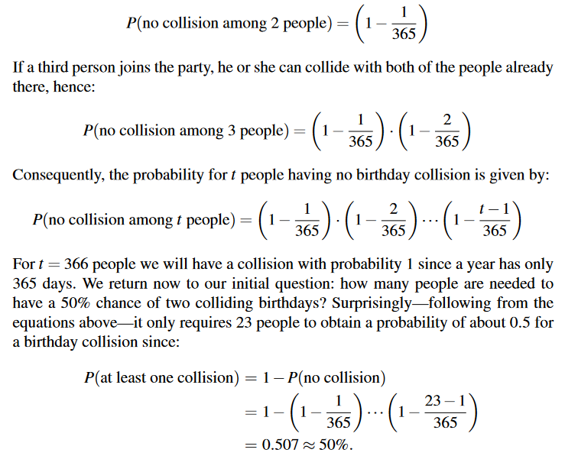
Hash Functions and Security
Halil İbrahim Kaplan
Hash Based Signatures

Slide 13
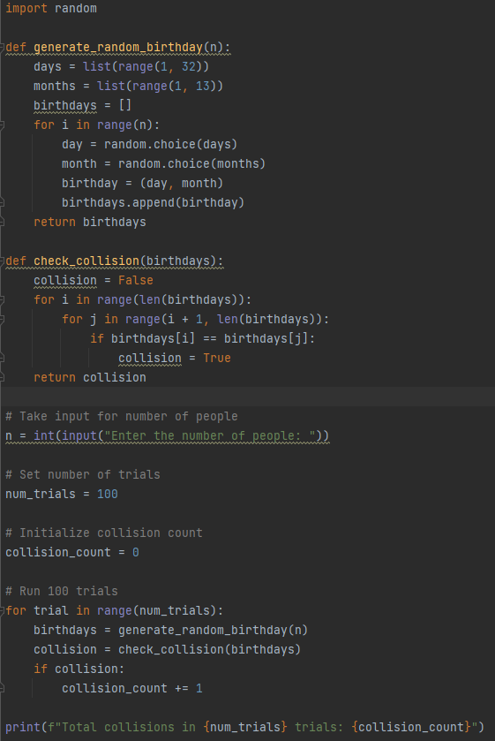
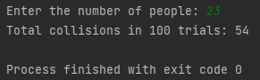
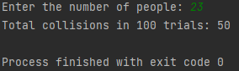
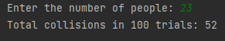
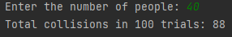
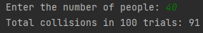
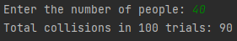
Hash Functions and Security
Halil İbrahim Kaplan
Hash Based Signatures

Slide 14
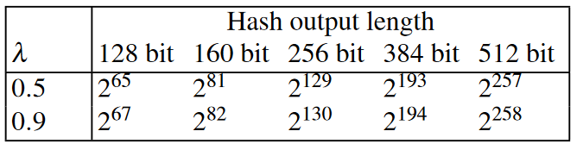
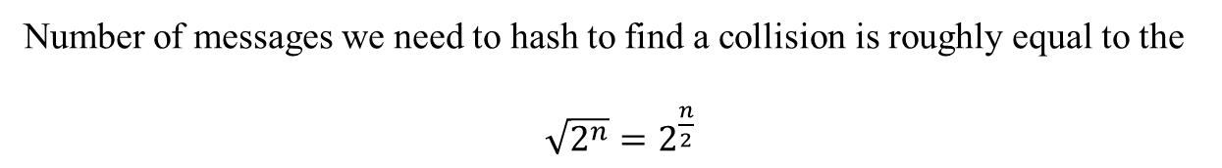
Hash Functions and Security
Number of messages we need to hash to find a collision is roughly equal to the
$\sqrt{2^{n}}=2^{\frac{n}{2}}$
Halil İbrahim Kaplan
Hash Based Signatures

Slide 15
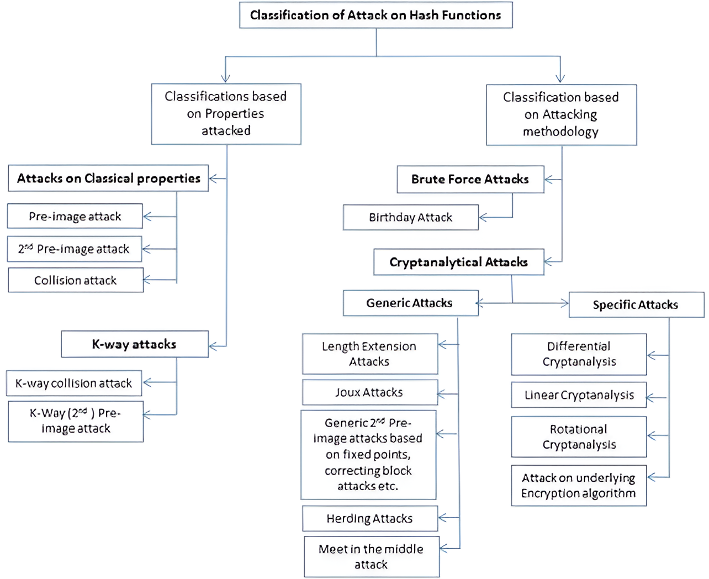
Hash Functions and Security
Halil İbrahim Kaplan
Hash Based Signatures

Slide 16
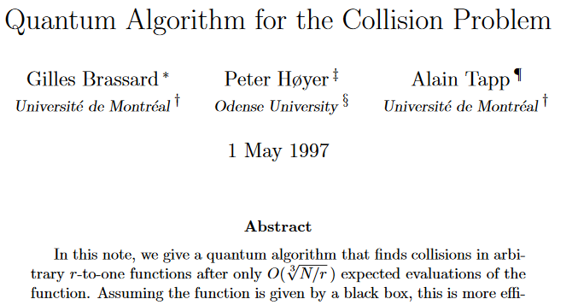
Hash Functions and Security
What about finding collision with Quantum Computer ?
Halil İbrahim Kaplan
Hash Based Signatures

Slide 17
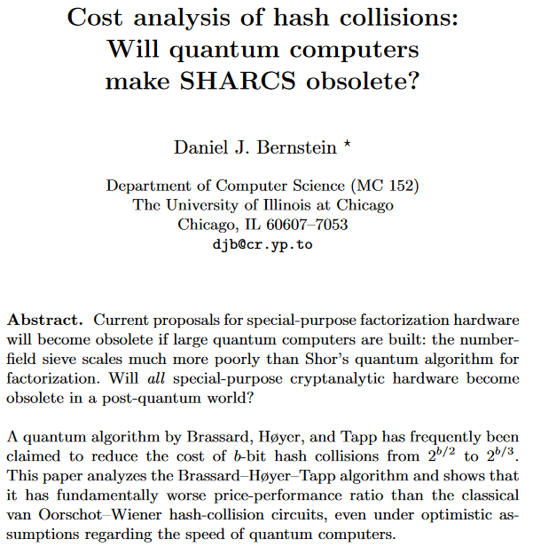
Hash Functions and Security
What about finding collision with Quantum Computer ?
Halil İbrahim Kaplan
Hash Based Signatures

Slide 18
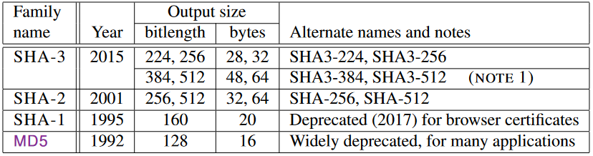
Hash Functions and Security
Halil İbrahim Kaplan
Hash Based Signatures

Slide 19
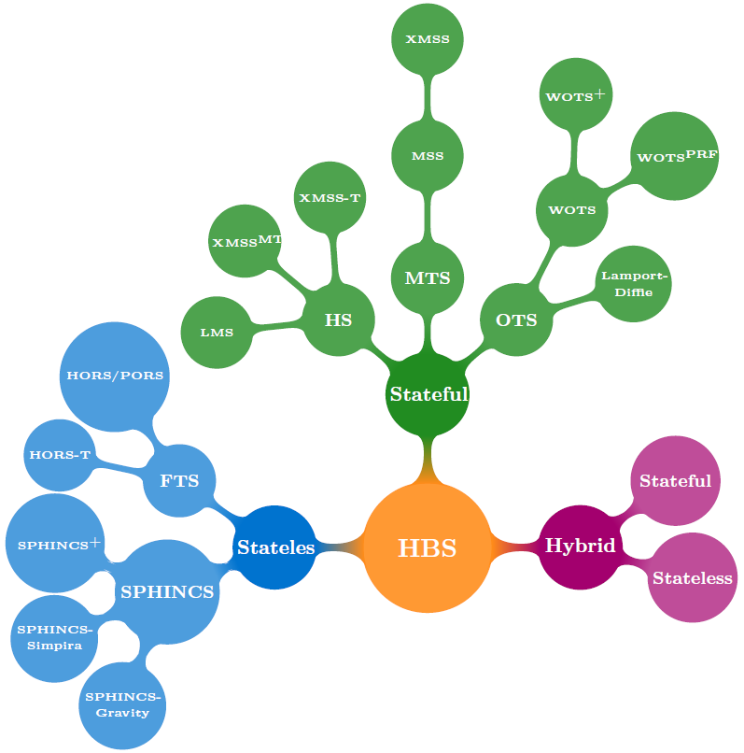

Slide 20
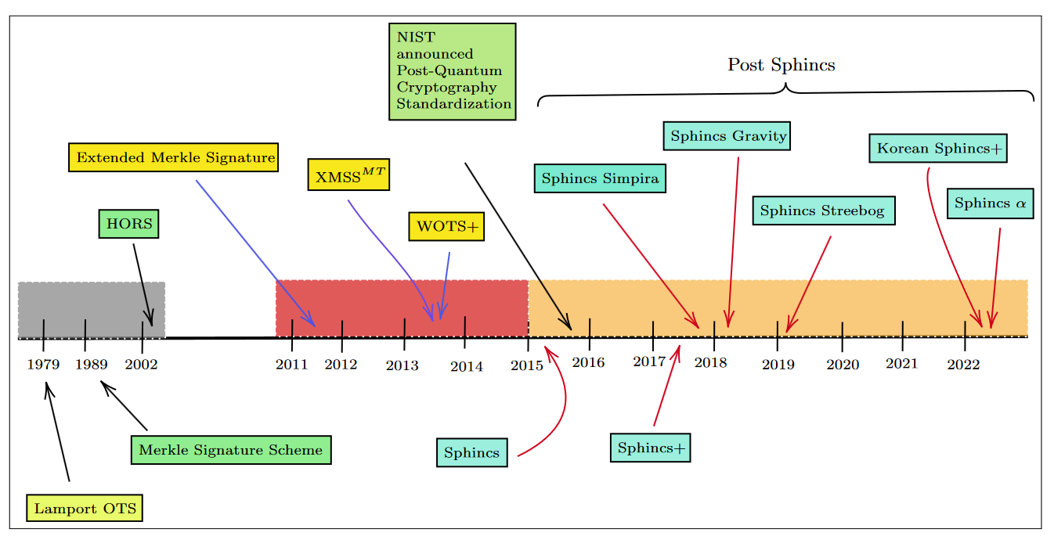

Slide 21
Lamport One-Time Signature

Slide 22
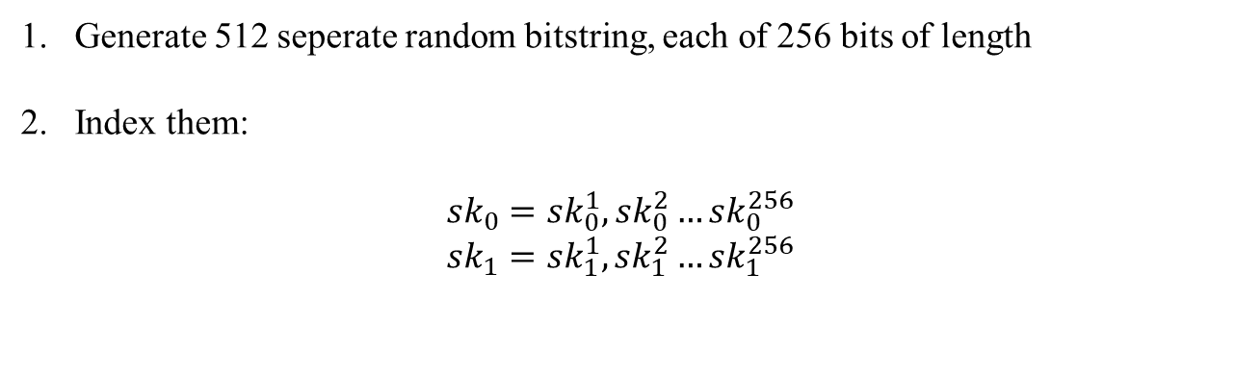
Lamport One-Time Signature
Hash function : H(256 bits output)
Message : M=(256 bits)
Signature : S=(256 bits)
Generate 512 seperate random bitstring, each of 256 bits of length
Index them:
$${sk}_{0}={sk}_{0}^{1},{sk}_{0}^{2}…{sk}_{0}^{256}$$
$${sk}_{1}={sk}_{1}^{1},{sk}_{1}^{2}…{sk}_{1}^{256}$$
Halil İbrahim Kaplan
Hash Based Signatures

Slide 23
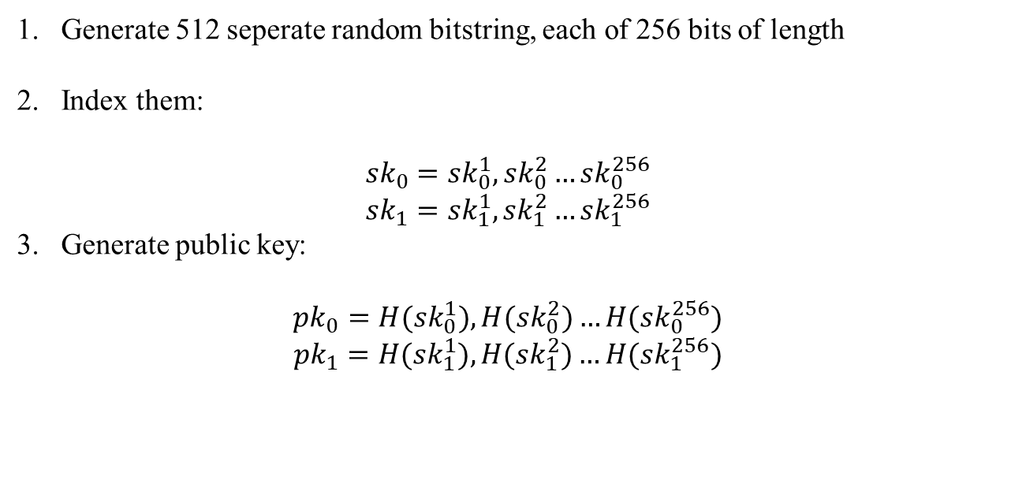
Lamport One-Time Signature
Hash function : H(256 bits output)
Message : M=(256 bits)
Signature : S=(256 bits)
Generate 512 seperate random bitstring, each of 256 bits of length
Index them:
$${sk}_{0}={sk}_{0}^{1},{sk}_{0}^{2}…{sk}_{0}^{256}$$
$${sk}_{1}={sk}_{1}^{1},{sk}_{1}^{2}…{sk}_{1}^{256}$$
Generate public key:
$${pk}_{0}={H(sk}_{0}^{1}),H({sk}_{0}^{2})…{H(sk}_{0}^{256})$$
$${pk}_{1}={H(sk}_{1}^{1}),H({sk}_{1}^{2})…{H(sk}_{1}^{256})$$
Halil İbrahim Kaplan
Hash Based Signatures

Slide 24
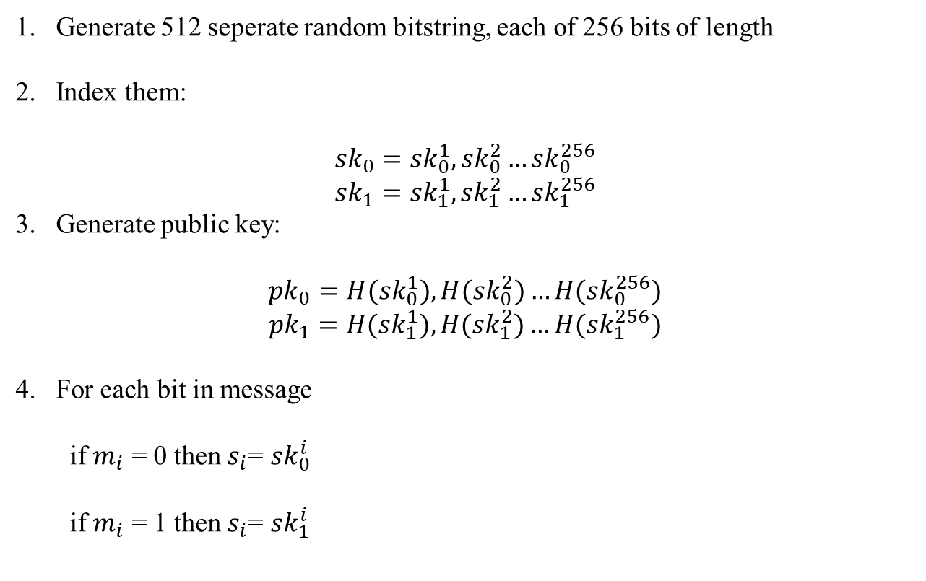
Lamport One-Time Signature
Hash function : H(256 bits output)
Message : M=(256 bits)
Signature : S=(256 bits)
Generate 512 seperate random bitstring, each of 256 bits of length
Index them:
$${sk}_{0}={sk}_{0}^{1},{sk}_{0}^{2}…{sk}_{0}^{256}$$
$${sk}_{1}={sk}_{1}^{1},{sk}_{1}^{2}…{sk}_{1}^{256}$$
Generate public key:
$${pk}_{0}={H(sk}_{0}^{1}),H({sk}_{0}^{2})…{H(sk}_{0}^{256})$$
$${pk}_{1}={H(sk}_{1}^{1}),H({sk}_{1}^{2})…{H(sk}_{1}^{256})$$
For each bit in message
if $m_{i}$ = 0 then $s_{i}$= ${sk}_{0}^{i}$
if $m_{i}$ = 1 then $s_{i}$= ${sk}_{1}^{i}$
Halil İbrahim Kaplan
Hash Based Signatures

Slide 25
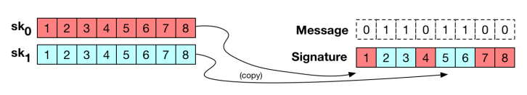
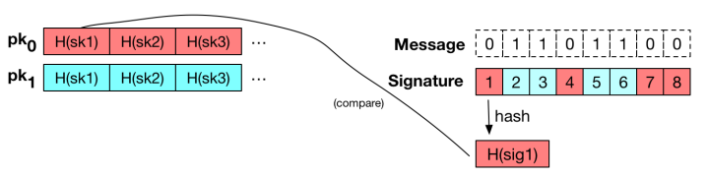
Lamport One-Time Signature
Halil İbrahim Kaplan
Hash Based Signatures

Slide 26
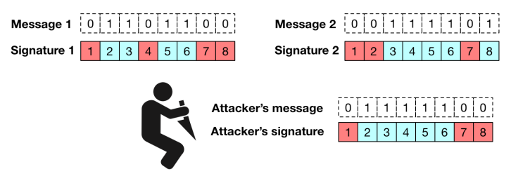
Lamport One-Time Signature
Each key can only be used to sign one message(OTP).
If not, mix and match forgery attack can be done.
Halil İbrahim Kaplan
Hash Based Signatures

Slide 27
Merkle’s tree-based signature

Slide 28
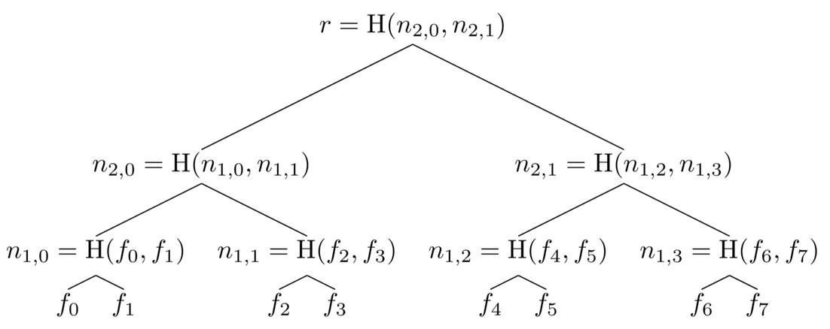
Merkle’s tree-based signature
Halil İbrahim Kaplan
Hash Based Signatures

Slide 29
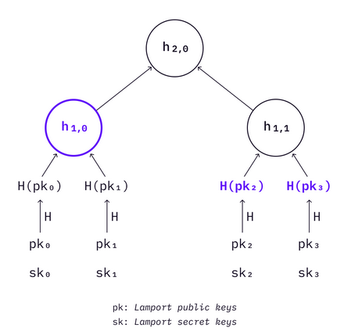
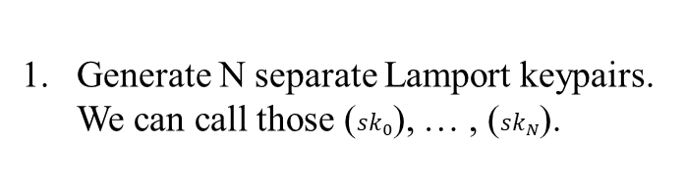
Merkle’s tree-based signature
Tranforms one-time signatures to many-time signatures.
Generate N separate Lamport keypairs. We can call those (${sk}_{0}$), … , (${sk}_{N}$).
Halil İbrahim Kaplan
Hash Based Signatures

Slide 30
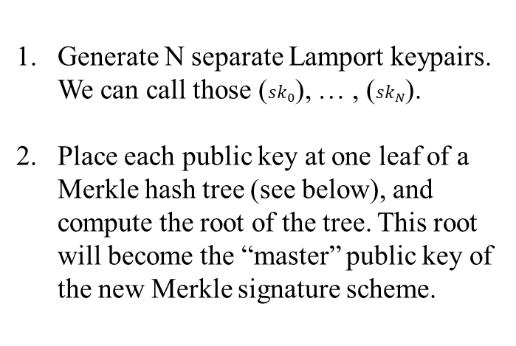
Merkle’s tree-based signature
Tranforms one-time signatures to many-time signatures.
Generate N separate Lamport keypairs. We can call those (${sk}_{0}$), … , (${sk}_{N}$).
Place each public key at one leaf of a Merkle hash tree (see below), and compute the root of the tree. This root will become the “master” public key of the new Merkle signature scheme.
Halil İbrahim Kaplan
Hash Based Signatures

Slide 31
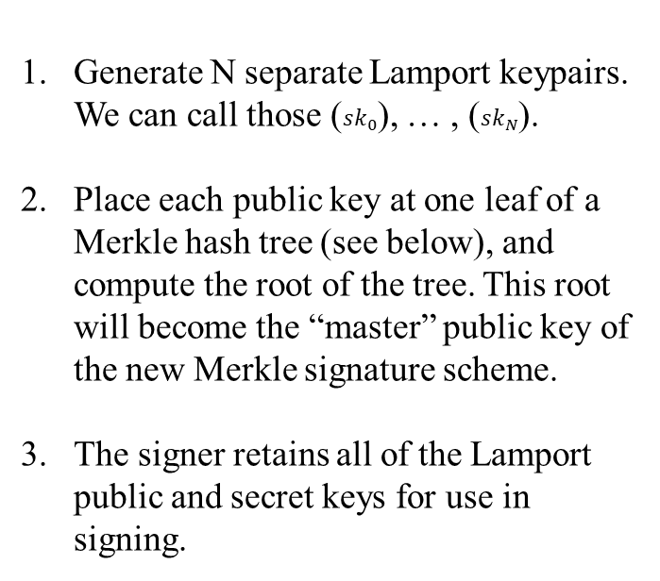
Merkle’s tree-based signature
Tranforms one-time signatures to many-time signatures.
Generate N separate Lamport keypairs. We can call those (${sk}_{0}$), … , (${sk}_{N}$).
Place each public key at one leaf of a Merkle hash tree (see below), and compute the root of the tree. This root will become the “master” public key of the new Merkle signature scheme.
The signer retains all of the Lamport public and secret keys for use in signing.
Halil İbrahim Kaplan
Hash Based Signatures

Slide 32
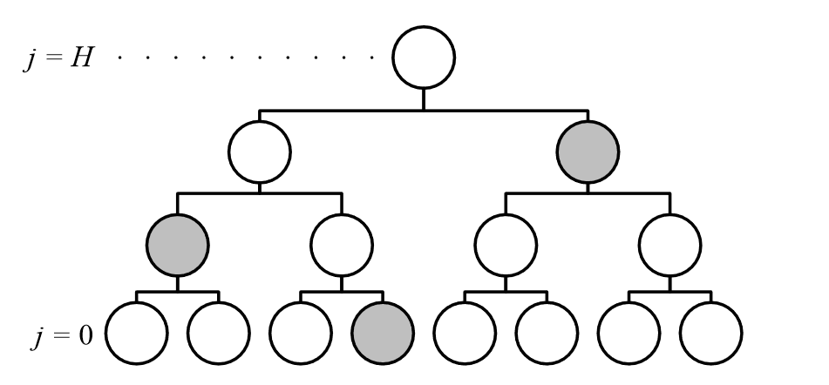
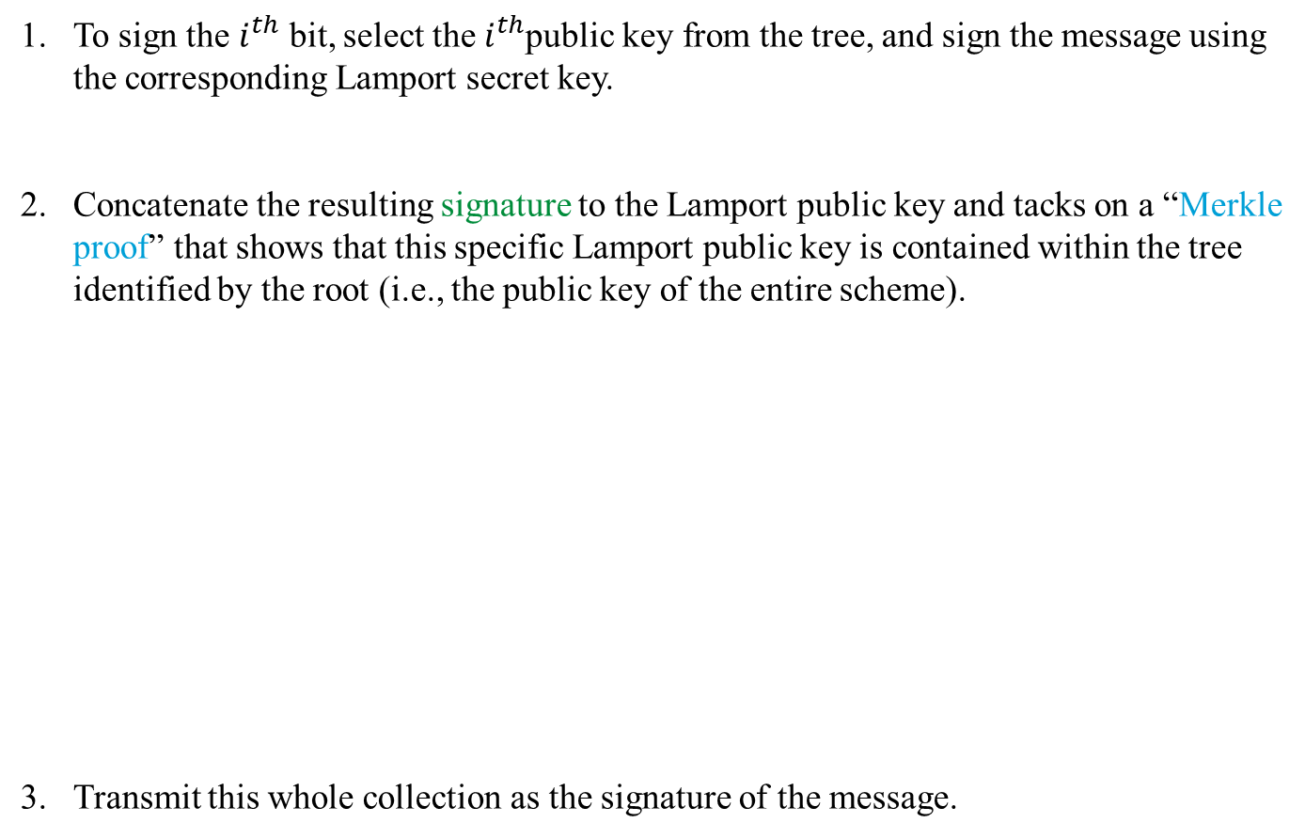
Merkle’s tree-based signature
To sign the $i^{th}$ bit, select the $i^{th}$public key from the tree, and sign the message using the corresponding Lamport secret key.
Concatenate the resulting signature to the Lamport public key and tacks on a “Merkle proof” that shows that this specific Lamport public key is contained within the tree identified by the root (i.e., the public key of the entire scheme).
Transmit this whole collection as the signature of the message.
Halil İbrahim Kaplan
Hash Based Signatures

Slide 33
Merkle’s tree-based signature
To verify a signature of this form,
Unpack this “signature” as a Lamport signature, Lamport public key, and Merkle Proof.
Use the Merkle Proof to verify that the Lamport public key is really in the tree.
If these three objectives achieved, Trust the signature as valid
Disadvantage
:
Signature size
:
Advantage
Public key is just 1 hash value
Halil İbrahim Kaplan
Hash Based Signatures

Slide 34
Merkle’s tree-based signature
IDEA: What if we don’t sign all of the message bits
Let’s say we sign only the message bits equal to one.
This would cut the public and secret key sizes in half.
VERY INSECURE
A
C
B
111… | abcd...
Message | Signature
000… | d...
Message | Signature
111… | abcd...
Message | Signature
Halil İbrahim Kaplan
Hash Based Signatures

Slide 35
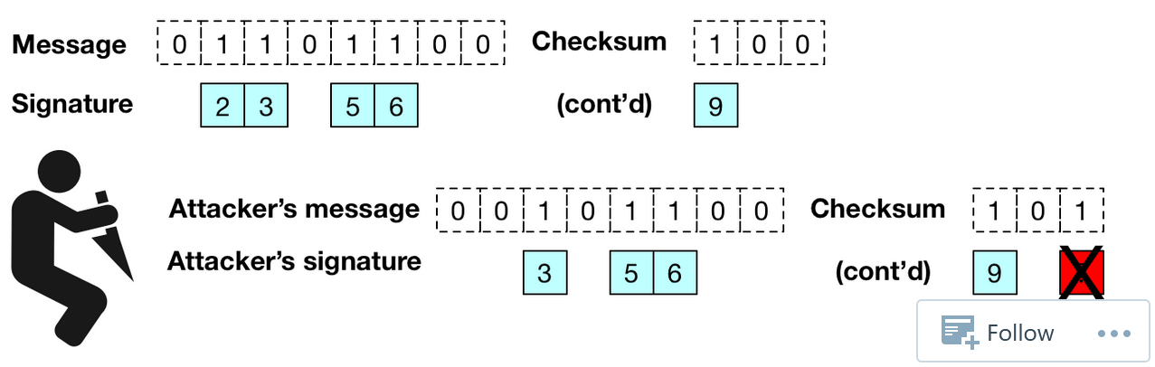
Merkle’s tree-based signature
We need to add checksum and sign checksum with message
Halil İbrahim Kaplan
Hash Based Signatures

Slide 36
WOTS

Slide 37
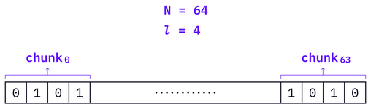
WOTS
IDEA: Divide message into N pieces of length l and sign each piece
We need secret and public key (For each possible value of piece)
Halil İbrahim Kaplan
Hash Based Signatures

Slide 38
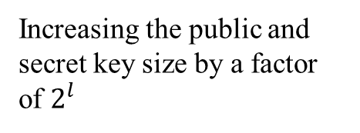
WOTS
IDEA: Divide message into N pieces of length l and sign each piece
We need secret and public key (For each possible value of piece)
The size of the signature by a factor of N
Increasing the public and secret key size by a factor of $2^{l}$
Reduces :
Cost:
What if we generated those key lists programatically only when we needed them?
NEW IDEA:
Halil İbrahim Kaplan
Hash Based Signatures

Slide 39
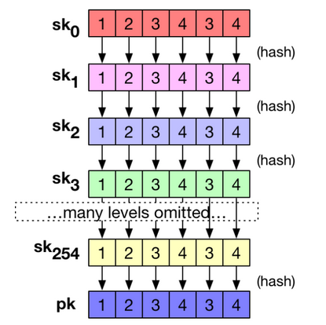
WOTS
Generate single list of random seeds for our initial secret key.
Rather than generating additional lists randomly, he proposed to use the hash function H(.) on each element of that initial secret key.
Public key could be derived by applying the hash function one more time to the final secret key list
Halil İbrahim Kaplan
Hash Based Signitures

Slide 40
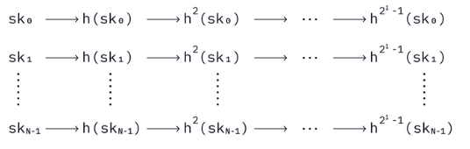
WOTS
Generate single list of random seeds for our initial secret key.
Rather than generating additional lists randomly, he proposed to use the hash function H(.) on each element of that initial secret key.
Public key could be derived by applying the hash function one more time to the final secret key list
Halil İbrahim Kaplan
Hash Based Signatures

Slide 41
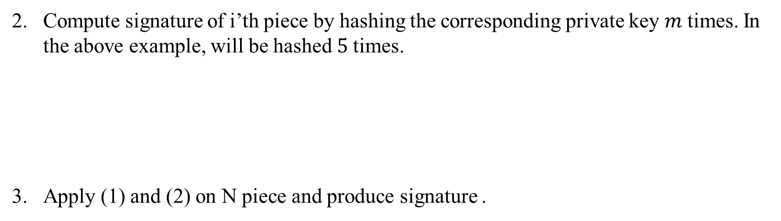
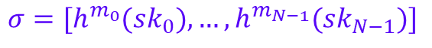
A WOTS signature is generated as follows,
Compute the decimal values of each piece from the message digest. For example, the decimal value of the first piece is 5(m).
Compute signature of i’th piece by hashing the corresponding private key $m$ times. In the above example, will be hashed $5$times.
Apply (1) and (2) on N piece and produce signature .
${sk}_{0}→h({sk}_{0})→h^{2}({sk}_{0})$ $→…→h^{5}({sk}_{0})$
$$σ=[h^{m_{0}}({sk}_{0}),…,h^{m_{N−1}}({sk}_{N−1})]$$

Slide 42
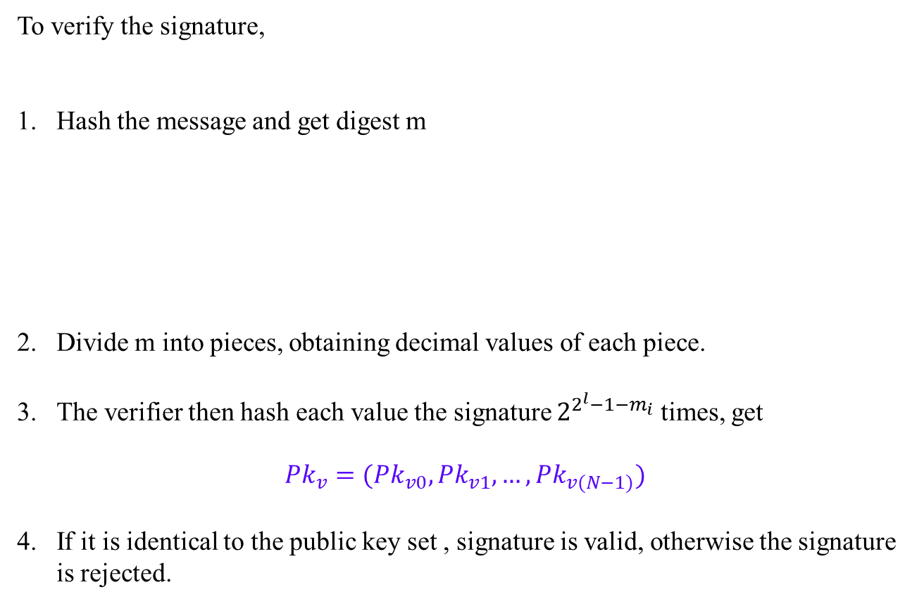
WOTS
To verify the signature,
Hash the message and get digest m
Divide m into pieces, obtaining decimal values of each piece.
The verifier then hash each value the signature $2^{{2^{l}−1−m}_{i}}$ times, get
${Pk}_{v}=({Pk}_{v0},{Pk}_{v1},…,{Pk}_{v(N−1)})$
If it is identical to the public key set , signature is valid, otherwise the signature is rejected.
Halil İbrahim Kaplan
Hash Based Signatures

Slide 43
WOTS+

Slide 44
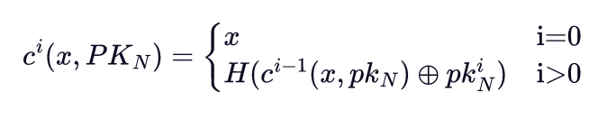
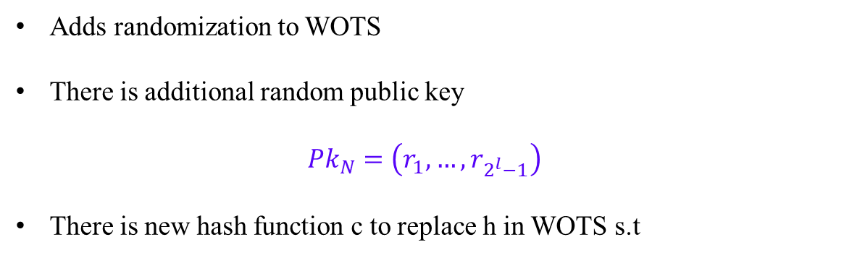
WOTS+
Adds randomization to WOTS
There is additional random public key
$${Pk}_{N}=\left(r_{1},…,r_{2^{l}−1}\right)$$
There is new hash function c to replace h in WOTS s.t
Halil İbrahim Kaplan
Hash Based Signatures

Slide 45
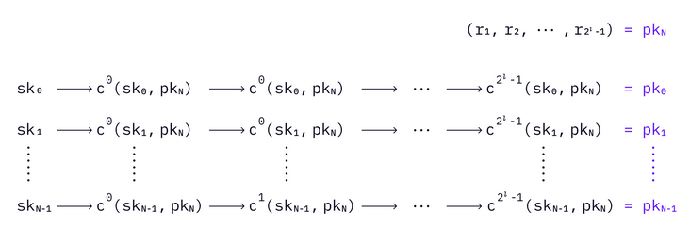
WOTS+
Halil İbrahim Kaplan
Hash Based Signatures

Slide 46
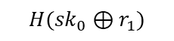
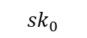

WOTS+
$${sk}_{0}$$
$$H({sk}_{0}⊕r_{1})$$
$$H(H({sk}_{0}⊕r_{1})⊕r_{2})$$
Halil İbrahim Kaplan
Hash Based Signatures

Slide 47

A WOTS+ signature is generated as follows,
Divide message m into N pieces ($m_{0}…m_{N−1}$) and compute checksum
$$C=\sum_{i=1}^{N−1}{(2^{l}−1−m_{i})}$$
then produce b = m || c
Compute signature
$$σ=\left(σ_{0}…σ_{N−1}\right)= [H^{b_{0}}({sk}_{0},{pk}_{N}),…,H^{b_{N−1}}({sk}_{N−1},{pk}_{N})]$$
Send signature with random ${pk}_{N}$ (${pk}_{N},σ$) to the verifier.

Slide 48
XMSS
The eXtended Merkle Tree Signature Scheme

Slide 49


Slide 50

XMSS
Uses Merkle tree to manage WOTS+ keys
Halil İbrahim Kaplan
Hash Based Signatures

Slide 51

L-tree
Halil İbrahim Kaplan
Hash Based Signatures

Slide 52

XMSS
Bitmasks are used in L-trees.
Before applying the hash function to two nodes each time, two bottom values will XOR with their corresponding bitmasks.
The leaves of a L-tree are WOTS+ public keys
Halil İbrahim Kaplan
Hash Based Signatures

Slide 53


Slide 54


Slide 55
XMSS
XMSS randomize each hash function
Using different key and different bitmask in each hash call
These values generated using seed and 32 byte ADRS value
Halil İbrahim Kaplan
Hash Based Signatures

Slide 56



XMSS
Address Scheme:
Halil İbrahim Kaplan
Hash Based Signatures

Slide 57

XMSS
base_w:
Halil İbrahim Kaplan
Hash Based Signatures

Slide 58

XMSS
WOTS+
WOTS+ uses the parameters n and w; they both take positive integer values.
• n: the security parameter; it is the message length as well as the length of a private key, public key, or signature element in bytes.
• w: the Winternitz parameter; it is an element of the set {4, 16}.
• len: the number of n-byte-string elements in a WOTS+ private key, public key, and signature
len = len1 + len2
Halil İbrahim Kaplan
Hash Based Signatures

Slide 59
XMSS
WOTS+ functions
F
accepts and returns byte strings of length n using keys of length n.
PRF
takes as input an n-byte key and a 32-byte index and generates pseudorandom outputs of length n
Halil İbrahim Kaplan
Hash Based Signatures

Slide 60

XMSS
2. when s=0, start hashing
İf # of hash bigger than w then return null
1. Put X inside of S-1 chain
For key
For bitmask
3. iteratively take s-1 hash and return the final hash
Halil İbrahim Kaplan
Hash Based Signatures

Slide 61

XMSS
sk[0] | sk[1] | … | sk[len-1]
n byte
Halil İbrahim Kaplan
Hash Based Signatures

Slide 62

XMSS
Obtain pk with taking w-1 times hash of sk
Halil İbrahim Kaplan
Hash Based Signatures

Slide 63

XMSS
Take msg[i] many hash of sk[i]
Halil İbrahim Kaplan
Hash Based Signatures

Slide 64

XMSS
Halil İbrahim Kaplan
Hash Based Signatures

Slide 65

XMSS
Take w-1-msg[i] many hash of sig[i] to reach pk[i] in the chain
Halil İbrahim Kaplan
Hash Based Signatures

Slide 66

XMSS
XMSS
public key
Merkel tree with h=2
WOTS+ public key
Halil İbrahim Kaplan
Hash Based Signatures

Slide 67

XMSS
Halil İbrahim Kaplan
Hash Based Signatures

Slide 68

XMSS
KEY
BM_0
xor
xor
BM_1
LEFT
RIGHT
Halil İbrahim Kaplan
Hash Based Signatures

Slide 69
XMSS
L-Trees:
Takes as input a WOTS+ public key pk and compresses it to a single n-byte value pk[0]
Halil İbrahim Kaplan
Hash Based Signatures

Slide 70


XMSS
Do until top node
If number of pk is not even
Add new pk same to last pk
Halil İbrahim Kaplan
Hash Based Signatures

Slide 72

Treehash:
Leaf at index s is a leftmost leaf of a sub-tree of height t

Slide 73
XMSS
N1234
i= 0 Stack={N1}
i= 1 Stack={N1,N12}
i= 2 Stack={N1,N12,N3}
i= 3 Stack={N1,N3,N12,N1234}
N12
N34
N1
N2
N3
N4
Halil İbrahim Kaplan
Hash Based Signatures

Slide 74

XMSS KeyGen:
Set adress to 0
Compute root with treehash

Slide 75

XMSS^{MT}

Slide 76
FORS
Forest of Random Subsets

Slide 77

FORS
Halil İbrahim Kaplan
Hash Based Signatures

Slide 78

FORS
H(m)= 100 011 011 101 111 000
Halil İbrahim Kaplan
Hash Based Signatures

Slide 79

FORS
HORS and FORS signatures of the message 100 011 110 where κ = 3 and t = 8.
Halil İbrahim Kaplan
Hash Based Signatures

Slide 80
SPHINCS+

Slide 81


Slide 82



Slide 83
Why eXtended Merkle Signature Scheme (XMSS) not candidates in the NIST Post-Quantum Cryptography Standardization process?
That is because NIST specifically stated that stateful schemes were not allowed in the NIST post-quantum competition, because they could not be implemented using the API that NIST has defined (which does not allow any state).
That would appear to be reasonable, as stateful hash based signature methods do need extra care to implement safely; NIST 800-208 outlines what NIST believes are reasonable precautions - those precautions are not needed for other algorithms, and hence NIST kept those separate

Slide 84


SPHINCS+
Tweakable Hash Functions:
To make each hash call independet we use tweakable hash functions
(defined as T_1)
Halil İbrahim Kaplan
Hash Based Signatures

Slide 85

SPHINCS+
PRF and Message Digest:
PRF for pseudorandom key generation:
to generate randomness for the message compression:
Keyed hash function that can process arbitrary length messages:
Halil İbrahim Kaplan
Hash Based Signatures

Slide 86
SPHINCS+
Address Scheme:
ADRS is a 32-byte value
All functions have to keep track of the current context, updating the addresses after each hash call.
There are 5 different types of addresses
Hashes in WOTS+ scheme
Compression of the WOTS+ public key
Hashes within the main Merkle tree construction
Hashes in the Merkle tree in FORS
Compression of the tree roots of FORS
Halil İbrahim Kaplan
Hash Based Signatures

Slide 87

SPHINCS+
Address Scheme:
describes the height of a tree within the hypertree starting from height zero for trees on the bottom layer.
describes the position of a tree within a layer of a multi-tree starting with index zero for the leftmost tree.
word 32 bit
consist of 3 words
defines the type of the address.
0 for a WOTS+ hash address
1 for the compression of the WOTS+ public key
2 for a hash tree address
3 for a FORS address
4 for the compression of FORS tree roots.
changes for each type
Halil İbrahim Kaplan
Hash Based Signatures

Slide 88



SPHINCS+
Address Scheme:
Halil İbrahim Kaplan
Hash Based Signatures

Slide 89



SPHINCS+
Address Scheme:
Halil İbrahim Kaplan
Hash Based Signatures

Slide 90

SPHINCS+
Address Scheme:
we refer to them respectively using the constants
WOTS_HASH
WOTS_PK
TREE
FORS_TREE
FORS_ROOTS
WOTS_PRF
FORS_PRF
Halil İbrahim Kaplan
Hash Based Signatures

Slide 91
SPHINCS+
WOTS+
WOTS+ uses the parameters n and w; they both take positive integer values.
• n: the security parameter; it is the message length as well as the length of a private key, public key, or signature element in bytes.
• w: the Winternitz parameter; it is an element of the set {4, 16, 256}.
• len: the number of n-byte-string elements in a WOTS+ private key, public key, and signature
len = len1 + len2
Halil İbrahim Kaplan
Hash Based Signatures

Slide 92
SPHINCS+
WOTS+
n determines
The in-and output length of the tweakable hash function used for WOTS+
The length of messages that can be processed by the WOTS+ signing algorithm.
w can be chosen from the set {4, 16, 256}
Larger value of w results in shorter signatures but slower operations; it has no effect on security.
Choices of w are limited since these values yield optimal trade-offs and easy implementation.
Halil İbrahim Kaplan
Hash Based Signatures

Slide 93

SPHINCS+
WOTS+
2. when s=0, start hashing
1. Put X inside of S-1 chain
3. iteratively take s-1 hash and return the final hash
Halil İbrahim Kaplan
Hash Based Signatures

Slide 94


SPHINCS+
WOTS+ Private Keys
SkADRS changes the secret key for each chain
Halil İbrahim Kaplan
Hash Based Signatures

Slide 95

SPHINCS+
WOTS+ Public Key Generation
Obtain sk from seed and address
Obtain tmp with taking w-1 times hash of sk
Take hash of tmp values and obtain pk
Halil İbrahim Kaplan
Hash Based Signatures

Slide 96

SPHINCS+
WOTS+ Signature Generation
Concatanates message and checksum
Produces different sk by changing adress value
Produces signature with hashing sk msg[i] times

Slide 97

SPHINCS+
WOTS+ Signature Generation

Slide 98

SPHINCS+
WOTS+ Public Key Computation from message and signature
Hash the signature w-1-msg[i] times
Take final hash and obtain pk

Slide 99
SPHINCS+
XMSS
XMSS has the following parameters:
h′ : the height (number of levels - 1) of the tree.
n : the length in bytes of messages as well as of each node.
w : the Winternitz parameter as defined for WOTS+
XMSS
public key
Merkel tree with h′=2 so can authenticates WOTS+ public keys
WOTS+ public key
Halil İbrahim Kaplan
Hash Based Signatures

Slide 100

SPHINCS+
XMSS
Must have even number of leafs
Halil İbrahim Kaplan
Hash Based Signatures

Slide 101

N1234
i= 0 Stack={N1}
i= 1 Stack={N1,N12}
i= 2 Stack={N1,N12,N3}
i= 3 Stack={N1,N3,N12,N1234}
N12
N34
N1
N2
N3
N4
Add node to the end of stack
Return to the end of stack and delete it from stack
Halil İbrahim Kaplan
Hash Based Signatures

Slide 102

SPHINCS+
XMSS
Halil İbrahim Kaplan
Hash Based Signatures

Slide 103


SPHINCS+
XMSS
Signature
Authentication node in layer 0
Halil İbrahim Kaplan
Hash Based Signatures

Slide 104

SPHINCS+
XMSS
Halil İbrahim Kaplan
Hash Based Signatures

Slide 105


SPHINCS+
XMSS
Changes according to position of node[0] in tree
Halil İbrahim Kaplan
Hash Based Signatures

Slide 106

SPHINCS+
The Hypertree
A HT is a tree of several layers of XMSS trees
All XMSS trees in HT have equal length
Consider a HT of total height h that has d layers of XMSS trees of height h′ = h/d.
Then layer d − 1 contains one XMSS tree, layer d − 2 contains $2^{\text{h}\text{′}}$ XMSS trees, and so on. Finally, layer 0 contains $2^{\text{h}\text{−}\text{h}\text{′}}$ XMSS trees
Halil İbrahim Kaplan
Hash Based Signatures

Slide 107
Hash

Slide 108

Layer 2
SIGN
Layer 1
…
SIGN
SIGN
SIGN
Layer 0
…
The Hypertree of height 9 with 3 layers consist of XMSS trees with height 3
Halil İbrahim Kaplan
Hash Based Signatures

Slide 109
Halil İbrahim Kaplan
Hash Based Signatures

Slide 110

SPHINCS+
The Hypertree
Halil İbrahim Kaplan
Hash Based Signatures

Slide 111

SPHINCS+
The Hypertree
32 byte consist of 0
Halil İbrahim Kaplan
Hash Based Signatures

Slide 112


SPHINCS+
The Hypertree
Sign the message with the lower XMSS tree
Continue signing in the hypertree up to layer d-1
Return all signatures
Halil İbrahim Kaplan
Hash Based Signatures

Slide 113

SPHINCS+
The Hypertree
Get signature of layer 0 XMSS
Compute pk of layer 0 XMSS
Get signature of layer j XMSS
Compute pk of layer j XMSS
If final node is equal to PK_HT, then signature is valid
Halil İbrahim Kaplan
Hash Based Signatures

Slide 114

SPHINCS+
FORS
Uses parameters k and t = 2ª
Signs strings of length ka bits
Privite key consist kt many random n byte strings
Public key n byte value computed as a hash of root node of k hash trees
k trees
height a
n byte
t times
Halil İbrahim Kaplan
Hash Based Signatures

Slide 115

SPHINCS+
FORS
Halil İbrahim Kaplan
Hash Based Signatures

Slide 116

SPHINCS+
FORS
Obtain sk from SK.seed
Returns just 1 sk not array of sk's
Halil İbrahim Kaplan
Hash Based Signatures

Slide 117

SPHINCS+
FORS
Almost same to treehash in XMSS
Halil İbrahim Kaplan
Hash Based Signatures

Slide 118


SPHINCS+
FORS
Compute top node of each tree
Take hash of the roots and obtain pk
Halil İbrahim Kaplan
Hash Based Signatures

Slide 119

SPHINCS+
FORS
Take corresponding sk of message chunk
Halil İbrahim Kaplan
Hash Based Signatures

Slide 120

SPHINCS+
FORS
Halil İbrahim Kaplan
Hash Based Signatures

Slide 121


Do for all trees
Get sk
Take hash of sk and enter the tree
Hash sk with corresponding layer auth
Give result to the node[0] and cont. with next auth.
Add root of i'th tree to the array
Take hash of the root values

Slide 122


Slide 123
SPHINCS+
PARAMETERS
n : the security parameter in bytes.
w : the Winternitz parameter
h : the height of the hypertree
d : the number of layers in the hypertree
k : the number of trees in FORS
t : the number of leaves of a FORS tree
Halil İbrahim Kaplan
Hash Based Signatures

Slide 124

SPHINCS+
Halil İbrahim Kaplan
Hash Based Signatures

Slide 125

SPHINCS+
Used in generation WOTS+ and FORS privete keys.
Used in generation randomization value for randomized message hash
SPHINCS+ public key
SPHINCS+ secret key
Halil İbrahim Kaplan
Hash Based Signatures

Slide 126

SPHINCS+
Give 0 to the adress
Gives option so that signiture of same message will be different in each sign
Generate random number R
split digest into 3 parts
Halil İbrahim Kaplan
Hash Based Signatures

Slide 127

SPHINCS+
Halil İbrahim Kaplan
Hash Based Signatures

Slide 128

SPHINCS+
SPHINCS+ signature
Halil İbrahim Kaplan
Hash Based Signatures

Slide 129
SPHINCS+
SPHINCS+ signature verification:
recomputing message digest and index,
computing a candidate FORS public key
verifying the HT signature on that public key.
Halil İbrahim Kaplan
Hash Based Signatures

Slide 130


Split signature

Slide 131

NIST security level 1 |  | Size(bytes) |  | Relative time
 |  | Public key | Signature | Verification | Signing
Non PQ | NIST p-256 ECDSA | 64 | 64 | 1(base) | 1(base)
 | RSA-2048 | 256 | 256 | 0.2 | 25
NIST selected algortihms | Dilithium2 | 1320 | 2420 | 0.3 | 2.5
 | Falcon512 | 897 | 666 | 0.3 | 5
 | SPHINC+-128s har. | 32 | 7856 | 1.7 | 3000
 | SPHINC+-128f har. | 32 | 17088 | 4 | 200
Others, | XMSS-SHAKE_20_128 (can sign 1000000 messages) | 32 | 900 | 2 | 10
https://blog.cloudflare.com/sizing-up-post-quantum-signatures/

Slide 132


small
fast

Slide 133


Slide 134

ANTONOV’S ATTACK
Halil İbrahim Kaplan
Hash Based Signatures

Slide 135

ANTONOV’S ATTACK
Halil İbrahim Kaplan
Hash Based Signatures

Slide 136

ANTONOV’S ATTACK
This attack uses Merkle-Damgard Structure of SHA-256 algorithm.
Halil İbrahim Kaplan
Hash Based Signatures

Slide 137

ANTONOV’S ATTACK
We want to construct diamond structure.
Halil İbrahim Kaplan
Hash Based Signatures

Slide 138

ANTONOV’S ATTACK
Halil İbrahim Kaplan
Hash Based Signatures

Slide 139

ANTONOV’S ATTACK
Assume that we have target messages M_{0,},…, M₅.
For each message, different address values used in hash algorithm ADRS₀, ..., ADRS₅.
In the first part we get intermediate hash value for addresses
$$H_{0}^{(1)}=C(iv, {ADRS}_{0})$$
$$H_{1}^{(1)}=C(iv, {ADRS}_{1})$$
$$H_{2}^{(1)}=C(iv, {ADRS}_{2})$$
$$H_{3}^{(1)}=C(iv, {ADRS}_{3})$$
$$H_{4}^{(1)}=C(iv, {ADRS}_{4})$$
$$H_{5}^{(1)}=C(iv, {ADRS}_{5})$$
Halil İbrahim Kaplan
Hash Based Signatures

Slide 140

ANTONOV’S ATTACK
Attacker finds x_{o} ,..., x₅ with collision attack.
$$H_{0,1}^{(2)}=C\left(H_{0}^{\left(1\right)},x_{0}\right)=C\left(H_{1}^{\left(1\right)},x_{1}\right)$$
$$H_{2,3}^{(2)}=C\left(H_{2}^{\left(1\right)},x_{2}\right)=C\left(H_{3}^{\left(1\right)},x_{3}\right)$$
$$H_{4,5}^{(2)}=C\left(H_{4}^{\left(1\right)},x_{4}\right)=C\left(H_{5}^{\left(1\right)},x_{5}\right)$$
Halil İbrahim Kaplan
Hash Based Signatures

Slide 141

ANTONOV’S ATTACK
For the three intermediate hash value, three way collision is found with random values x_{0,1}, x_{2,3}, x_{4,5.}
$$H_{0…5}^{(3)}=C\left(H_{0,1}^{\left(2\right)},x_{0,1}\right)=C\left(H_{2,3}^{\left(2\right)},x_{2,3}\right)=C\left(H_{4,5}^{\left(2\right)},x_{4,5}\right)$$
Halil İbrahim Kaplan
Hash Based Signatures

Slide 142

ANTONOV’S ATTACK
As a last part, attacker finds z so that it satisfies the below equation for some i $ε${0,...,5}
$$C\left(H_{0…5}^{\left(3\right)}, z||padding\right)=SHA−256({ADRS}_{i},M_{i})$$
For example when preimage found for M3, below equation will be satisfied and multi-target preimage attack will be done
SHA-256 (ADRS₃||x₃||X_{2,3}||Z)=SHA-256 (ADRS₃,M₃)
Halil İbrahim Kaplan
Hash Based Signatures

Slide 143

ANTONOV’S ATTACK
Given t target messages, the expected cost for the final step in the attack, finding a preimage, is $\frac{2^{256}}{t}$calls to the compression function, C.
The preceding steps require performing O(t) collision attacks. The expected cost of each collision attack will depend on whether a 2-way, 3-way, 4-way, etc. collision is sought.
In general, the expected cost of finding an n-way collision is ${O(2}^{256(n−1)/n})$ calls
to the compression function.
Halil İbrahim Kaplan
Hash Based Signatures

Slide 144

ANTONOV’S ATTACK
Halil İbrahim Kaplan
Hash Based Signatures

Slide 145
ANTONOV’S ATTACK
Step 1:
At this step, the attacker obtains a certain amount of message-signature pairs signed with the same hash-based signature algorithm. Since the WOTS+ public keys used in the signature can be derived from the signature, the attacker also gains access to the WOTS+ public keys.
Attacker prefers messages with as low a checksum value as possible. (As the checksum values decrease, the probability of the w-base representations of the messages being F increases.) While the PK-seed values of the message-signature pairs are the same, the ADRS values are different for each pair.
The values P1,...,P8 represent the ADRS and PK.seed values. Finally, the attacker sorts the P1,...,P8 values.
Halil İbrahim Kaplan
Hash Based Signatures

Slide 146

ANTONOV’S ATTACK
Step 2:
At this step, the attacker takes the hash of the randomly chosen values sk1,...,skn, each $2^{w}$ times, and then appends these values together. The attacker then obtains the concatenated values free1,...,free8, which correspond to the WOTS+ public keys associated with the chosen sk values.
Halil İbrahim Kaplan
Hash Based Signatures

Slide 147
ANTONOV’S ATTACK
Step 3:
At this step, the attacker appends random h values to the end of the free values and finds an n-way collision using the method described at the beginning of this section. The values added here correspond to WOTS+ public keys; however, unlike in stage 2, at this stage, the attacker does not know the secret key corresponding to the WOTS+ public key.
Halil İbrahim Kaplan
Hash Based Signatures

Slide 148
ANTONOV’S ATTACK
Step 4:
At this step, the attacker compares the n-way collision value h30 they obtained with the public keys they aim to collide with. (The values TO,...,T7 correspond to the targeted public key without the checksum added.) If a collision is found at this stage, the attacker successfully produces a new WOTS+ public key with the same hash value as the genuine public key.
Halil İbrahim Kaplan
Hash Based Signatures

Slide 149
ANTONOV’S ATTACK
As a result of the above stages, the attacker can generate a fake signature with the forged key they produced. In the SPHINCS+ and XMSS algorithms, when verifying a signature, the public keys obtained at each layer are not checked; instead, their hash values are taken, and this value is signed in the next layer. Therefore, even if the public keys obtained by the attacker differ from the real public keys, no error occurs during the verification of the fake signature because the hash values are the same.
Halil İbrahim Kaplan
Hash Based Signatures

Slide 150
ANTONOV’S ATTACK
The biggest constraint in this attack is that the form of the message that the attacker can sign must be as follows:
XXXXXXXX XXXXXXXX XXXXXXXF FFFFFFFF FFFFFFFF FFFFFFFF FFFFFFFF FFFFFFFF (X can take any value.)
The reason for this is that the attacker knows the secret keys corresponding to the public keys used in stage 2, but not those in stage 3.
In a WOTS+ signature, the pk value is used as the signature for the F value, so the message must contain F in the parts where the secret key is unknown for the attack to be successful.
Halil İbrahim Kaplan
Hash Based Signatures

Slide 151
REFERENCES
Aumasson JP, Bernstein DJ, Beullens W, Dobraunig C, Eichlseder M, Fluhrer S, Gazdag SL, Hülsing A, Kampanakis P, Kölbl S, Lange T, Lauridsen MM, Mendel F, Niederhagen R, Rechberger C, Rijneveld J, Schwabe P, Westerbaan B (2022) SPHINCS+ – Submission to the NIST post-quantum project, v.3.1. Available at https://sphincs.org/data/sphincs+-r3.1- specification.pdf.
Hülsing A, Butin D, Gazdag SL, Rijneveld J, Mohaisen A (2018) XMSS: eXtended Merkle Signature Scheme. (Internet Research Task Force (IRTF)), IRTF Request for Comments (RFC) 8391. https://doi.org/10.17487/RFC8391.
Cooper DA, Apon D, Dang QH, Davidson MS, Dworkin MJ, Miller CA (2020) Recommendation for Stateful Hash-Based Signature Schemes. (National Institute of Standards and Technology, Gaithersburg, MD), NIST Special Publication (SP) 800-208. https://doi.org/10.6028/NIST.SP. 800-208.
Perlner R, Kelsey J, Cooper D (2022) Breaking Category Five SPHINCS+ with SHA-256. Post-Quantum Cryptography, eds Cheon JH, Johansson T (Springer International Publishing,Cham), pp 501–522. https://doi.org/10.1007/978-3-031-17234-2_23.
Halil İbrahim Kaplan
Hash Based Signatures

